Slide 1

Remind Me At Presentation
Presented By- Internship Team-4(MAD-316)
Patel Dhruvkumar Jayantibhai (1992744)
Varma Akshay Chandrashekhar (1992658)
Tanvi Gakhar (1992591)
Kamaljit Kaur (1992622)
Sarbjit Kaur (1992849)
Dankhara Chintan (1992663)
Karthik Modubowna (1894247)
Guided By-
Prof. Pargol Poshtareh
Prof. Haythem Rehouma
Prof. Sakshi Sharma
Prof. Navpreet Kaur
Git Hub Link:-https://github.com/dhruv5418/RemindMeAt.git
Prototype Link:-https://www.justinmind.com/usernote/tests/44751178/48474142/48474144/index.html

Slide 2
Project analysis slide 4
Chintan Dankhara- 1992663
Contents
01
07
01
About the Application
About the Application
Decisions we regret
08
02
08
Feature Selection
Technology Stack
Easier Than Expected
02
02
09
03
Reasons behind choosing the Technology
Problems faced during the Development
02
02
10
04
Technology Stack
Handling Git Conflicts
02
Working as a team
04
05
02
04
11
11
Future Enhancements
02
04
12
02
12
04
06
Pandemic Effect
References

Slide 3

Project analysis slide 5
Chintan Dankhara- 1992663
About the Application
Introduction
Purpose
Scope
Remind me at is an android based application for getting reminders on the basis of location
Just add a reminder and let the app do the rest of the work for you.
This app makes the lives of people easy and sorted as they can focus on other things rather than just thinking about small day to day things like groceries or meeting someone at some specific place, etc.
“Remind me at ” provides the facility to create the reminders on the basis of location and specific date.
Users can select the title, description and location for the reminder, they will get a notification about the reminder when they reached target location.
This application will help the users to accomplish their daily life works on the time without forgetting..
The scope of this application is help users to do the daily life chores without forgetting.
Users can set the reminders about any task which they want to do when they are on certain places.
To add a reminder user can add the title and description about the reminder so he will get all the necessary details which he want to finish on that location.
Users can repeat their old reminders.
Users can set active/inactive the reminders.

Slide 4






Project analysis slide 2
Feature Selection
Sarbjit Kaur- 1992849
Project definition understanding
Online research and idea gathering
Brainstorming
Group discussion
Feature review with teachers
Documentation created

Slide 5

Project analysis slide 3
Sarbjit Kaur- 1992849
Reasons behind choosing
the technology
Java programming language support with the help of a rich set of libraries.
XML and downloadable fonts for good designing.
As per IDC expects Android’s smartphone share in market is highest among all other OS which is around 86% in 2020.
Faster build time because of Android instant apps support.
Android SDK is open-source.

Slide 6



Project analysis slide 6
Dhruv Patel-1992744
Reasons behind choosing
the technology
Firebase:-
The ready-to-use services include Storage functions, authentication and cloud Database. That greatly facilitates the work of developers and letting them focus on the overall experience the product has to offer
Node JS:-Firebase Admin SDK needs a server app, on which it will be initialized because doesn’t provide SDK for android. Node comes with NPM(node package manager) which provides numerous libraries and reusable templates.
Google Map’s API :-
Google Map’s APIs are very powerful, but what is even more powerful is the combination of more than one API. Like-Places, Routes and Maps.

Slide 7










Project analysis slide 10
Dhruv Patel-1992744
Technology Stack
Front-End
Libraries
Firebase Services
Back-end
Admin Side

Slide 8

Project analysis slide 4
Tanvi Gakhar- 1992591
Working as a team
We spent time to know about teammates skills and expertise's and according to that we distributed our work.
After every iteration we did zoom meeting and we discussed about who could possibly develop which module, mistakes of previous iteration and according to that we assigned work to every one.
We tracked the record of work by giving constant updates to each other.
Work Distribution :
Dhruv :- Google map integration to show data, Foreground location service and Admin Node JS server and App Logo and Documentation.
Tanvi : - UI of backend of List View, search bar, Reminder notification, Filter for reminder, JavaDoc, Documentation and diagrams.
Akshay :- UI of backend of Splash Screen, backend of Add reminder, In map view markers and pop up, Documentation and Prototype.
Sarbjit :- UI and backend of SignUp, Login, Profile. JavaDoc and Documentation.
Kamaljit:- UI of Home screen, backend for managing reminder, code for checking internet connection, JavaDoc, Documentation and diagrams.
Chintan:- UI and backend of Admin dashboard, Animation java code, .documentation, prototype and JavaDoc.
Karthik :- UI and backend of Feedback, Drawer menu, UI and backend of Forgot password, Drwable resources, JavaDoc.

Slide 9



Project analysis slide 4
Tanvi Gakhar- 1992591
Pandemic Effect
In the beginning of project , all our team members used to work together by sitting in a common room . During that time, whenever we had new ideas, errors and new issues regarding project, we always tried to solve that by discussing or helping each others in the same day. Working together in one room was really great opportunity for all of us to learn new things from each other and also spending the quality time with friends.
Later on, when the Quebec government announced that the no gatherings are allowed from 1 October, we were in panic because it’s a group project so everyone has to work with coordination which was not easy without meeting and discussion. Therefore working remotely on the project was a great challenge for our team. In couple of days we had one or more zoom group calls where we were dividing the tasks, solving errors etc. Overall it was a great experience for us.
But this was our first step to learn how to work remotely from home with proper team coordination. Which will be good for us in future. It was difficult to collaborate and to develop project remotely but our team members showed great enthusiasm while working remotely

Slide 10
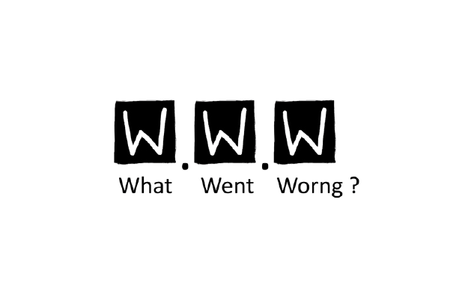
Project analysis slide 7
Tanvi Gakhar- 1992591
Decisions we Regret
Choosing firebase :-
After selecting firebase as our authentication and database provider we come to know that firebase doesn’t provides Admin SDK for android platform for managing user operation like delete, enable and disable user.
To overcome this we had to develop Node JS server using Firebase Admin SDK for user management operations.
Which help us to gain extra knowledge of Node JS, Express and NPM, so At the end it comes out beneficial.

Slide 11
Project analysis slide 7
Easier Than Expected
Kamaljit Kaur- 1992622
Use of Fused location provider:-
This was new concept for us to work on it and develop for our specific requirements. But with the help of Google documentation, tutorial and sample code it was really easier than expected.
Use of Google Places API:-
As we wanted to implement functionality where user can search for address directly and then select address from suggestions which was main task to provide better user experience. So for this Google Places API turned out with a blessing of step by step documentation and online tutorials.
Despite of working remotely our team managed to work in proper coordination, in group, by facing all the challenges throughout the internship. Which leads to on time delivery of complete and accurate product before the due date.

Slide 12
Project analysis slide 7
Kamaljit Kaur- 1992622
Problems faced during
the Development
Foreground location service :-
As we wanted to develop a service which runs continuously in the background it was challenging task. We need to considered many scenarios like OS optimization, device reboot and service auto-kill can stop the service. To overcome this kind of situation we need to add different receivers and code which can re-start the service automatically.
Memory and power consumption :-
As we wanted to implement functionality where user can select accuracy mode which can control device’s memory and power consumption in the background. It was quite challenging part to design this functionality.

Slide 13
Project analysis slide 7
Akshay Varma- 1992658
Problems faced during
the Development
Admin Side :-
As we are using firebase offer back end services like user authentication but for managing users from admin side firebase doesn’t provide Admin SDK for android platform. So, we have to learn Node JS to create server for performing user managing functionality like delete, enable and disable.
Google Map Fragment :-
Our app have one functionality in which we are showing all added reminders on map using markers. But there was one problem when user add more then one reminders for same location it was showing all markers overlapped on each other. To solve this problem we have implemented marker clustering in map fragment which helps to show marker in group for same location.

Slide 14


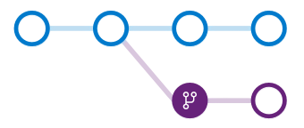

Project analysis slide 4
Akshay Varma- 1992658
Handling Git Conflicts
Team work:-
As we discussed early we believe in team work, we were working on individual modules which helps us to avoid major git conflicts.
Git branching:-
Git provides functionality called branching which helps a lot to merge git conflicts. But we were working on individual modules which helps us to avoid use of branching
Git Desktop :-
Whether you're new to Git or a seasoned user, GitHub Desktop simplifies your development workflow with GUI. It also helps to keep tracking of files and changes easily.
Git's website and documentation are good resources whenever we got stuck. We were able to find advanced information on Git merging, including merge-conflict resolution, in the advanced merging section.

Slide 15
Project analysis slide 7
Karthik Modubowna- 1894247
Future Enhancements
User will be able to add reminders with more options like date slot, particular time based, and reminders without location only based on time.
Notification feature with user settable ringing options like ring, vibrate and silent.
User will be able to add photo as a description with reminder.
User will be able to select option for getting notification while entering the location or exiting the location in future..
We will always strive to work on this app to make it more user-friendly.

Slide 16




Project analysis slide 7
Karthik Modubowna- 1894247
References
https://developer.android.com/guide
https://stackoverflow.com/
https://firebase.google.com/docs/android/setup
https://square.github.io/picasso/
https://material.io/
https://developers.google.com/maps/documentation/android-sdk/overview

Slide 17
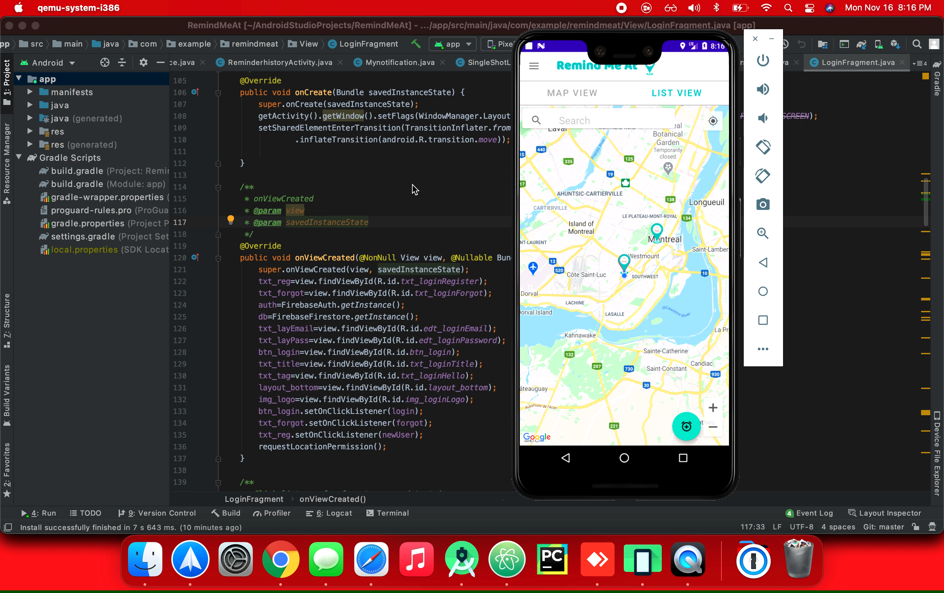
Project analysis slide 7
Karthik Modubowna- 1894247
Demo-Add Reminder

Slide 18
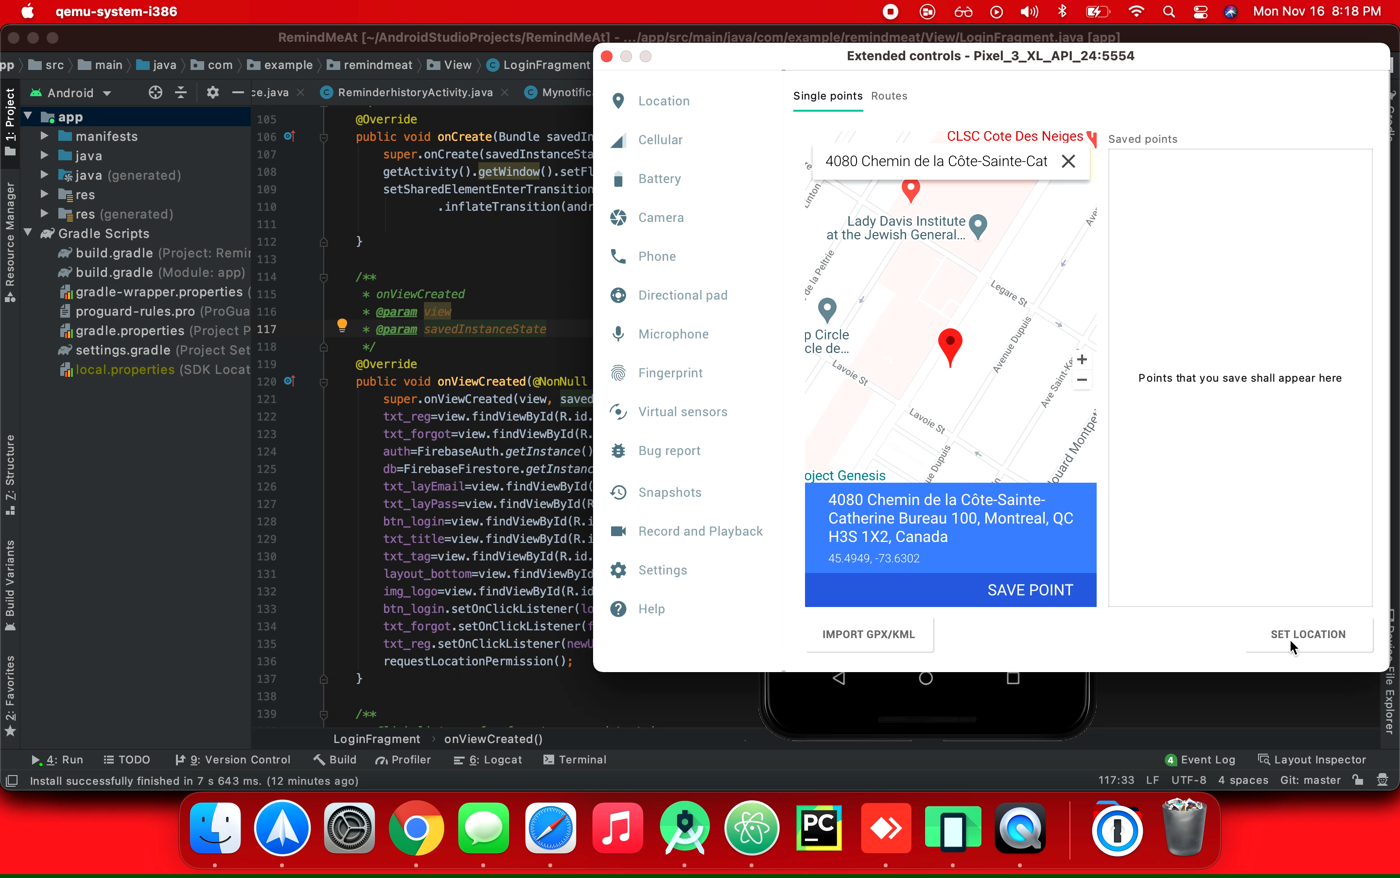
Project analysis slide 7
Karthik Modubowna- 1894247
Demo-Reminder Notification

Slide 19


Remind Me At Team
Dhruv Patel
A team that grew together
Akshay Varma
Tanvi Gakhar
Chintan
Sarbjit Kaur
Thank You
Karthik
Kamaljit Kaur

